Slide 1
WCD Final
DENNIS ELWELL

Slide 2
Contents
Architecture
Walk-Thru
Challenges
Questions

Slide 3

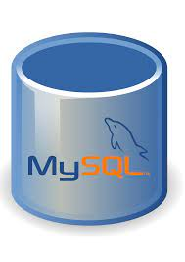
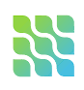



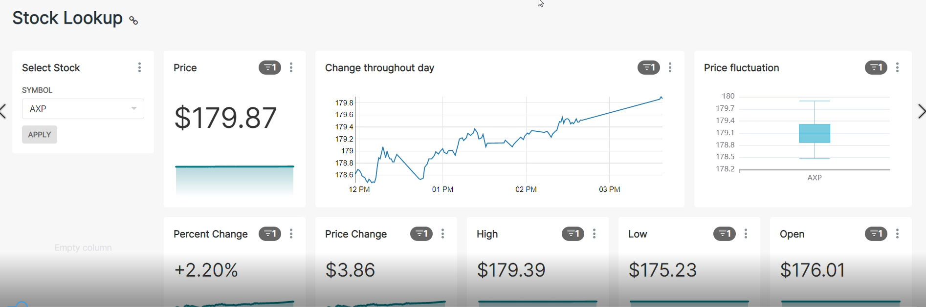



Architecture
API
Stock data API
NiFi
MySQL
Debezium
Kafka Cluster
EMR Cluster (spark job)
S3
Superset
Athena
Glue

Slide 4
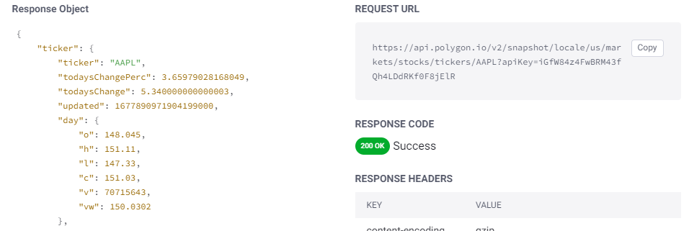
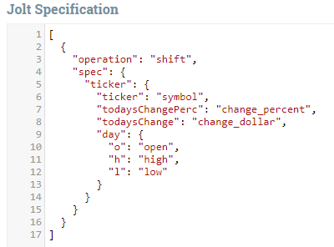
Part 1 – use NiFi to call stock API
Stock API
Jolt – processor in Nifi

Slide 5
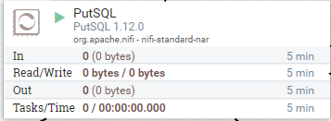
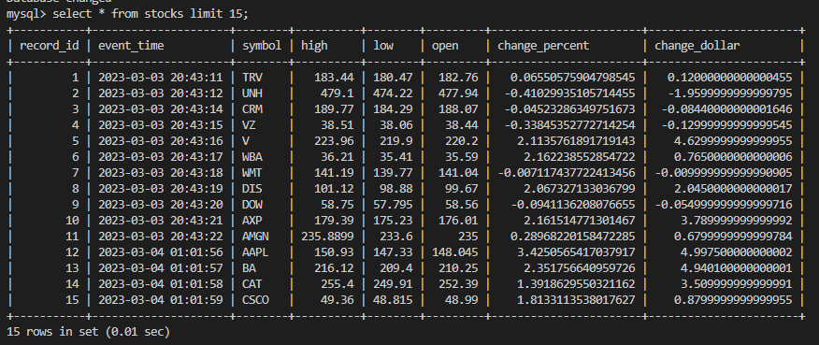
Part 2 – NiFi writes to MySQL database in EC2

Slide 6
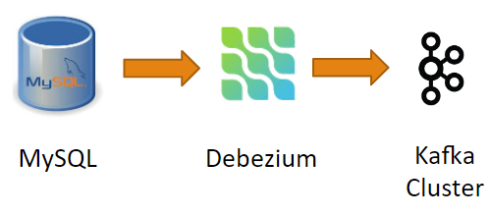
Part 3 – Debezium connect brings data from MySQL to Kafka cluster
Kafka cluster managed by MSK

Slide 7
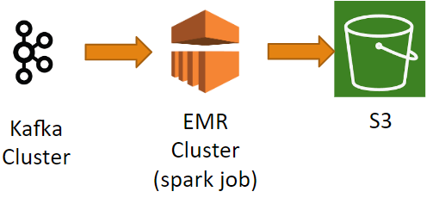
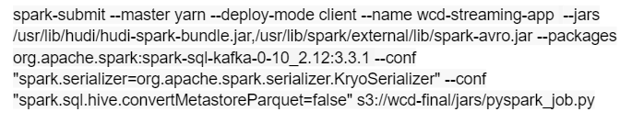
Part 4 – spark job in EMR reads topic in Kafka and writes to S3

Slide 8
Part 5 – Athena reads S3 data. Superset reads from Athena

Slide 10
Challenges
Finding a stock data API
NiFi
Querying 30+ stocks
Transforming JSON to usable format with JOLT
MySQL
Setting up a database with correct data types
EMR Cluster
Couldn’t run with Kafka in Docker
Didn’t run without NiFi being live
Superset
Getting the visuals I wanted to see

Slide 11
Thank you!

